Slide 1
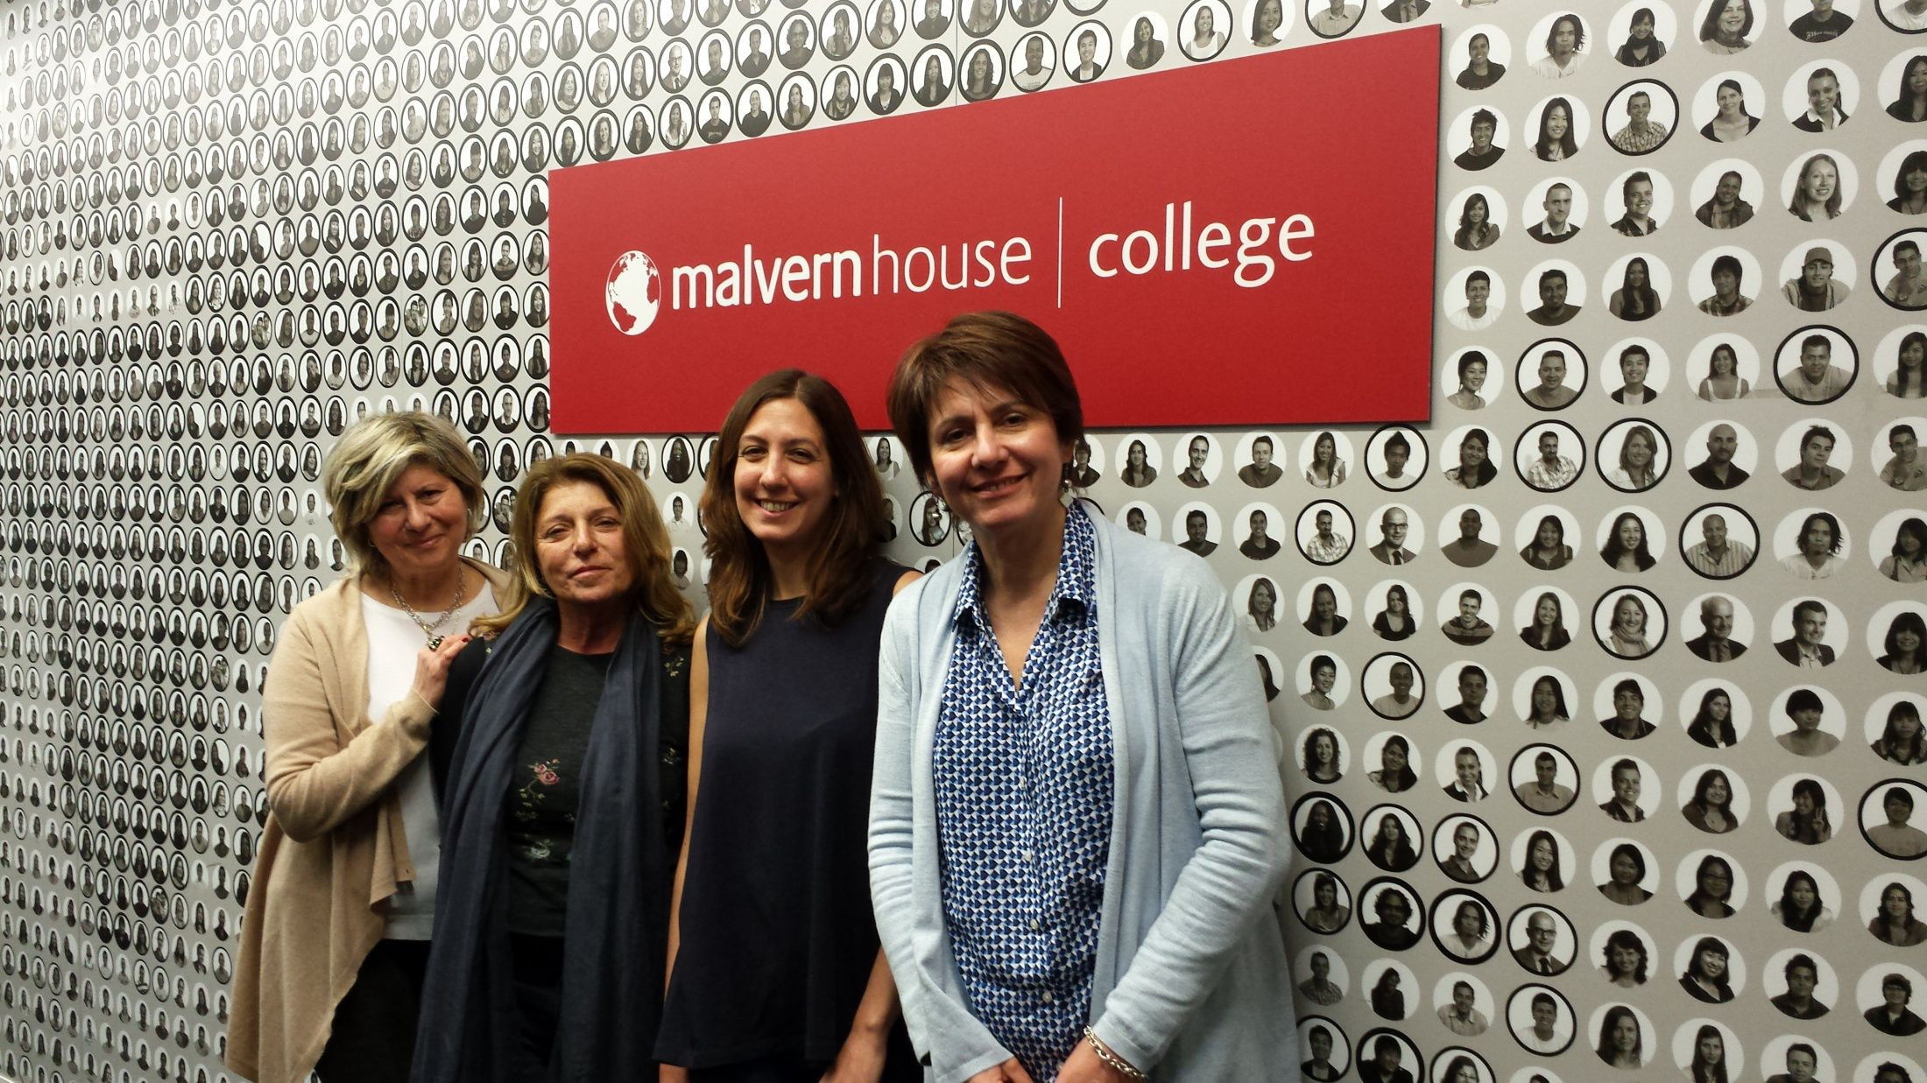
ERASMUS PLUS K1 m ERASMUS PLUS K1 Mobility: 1st April – 9th April 2017

Slide 2
MALVERN HOUSE LONDON
project leader: Teacher Rina Carfi’
EFL Teachers involved: Rina Carfì, Adriana Butera, Valeria Di Chiara

Slide 3
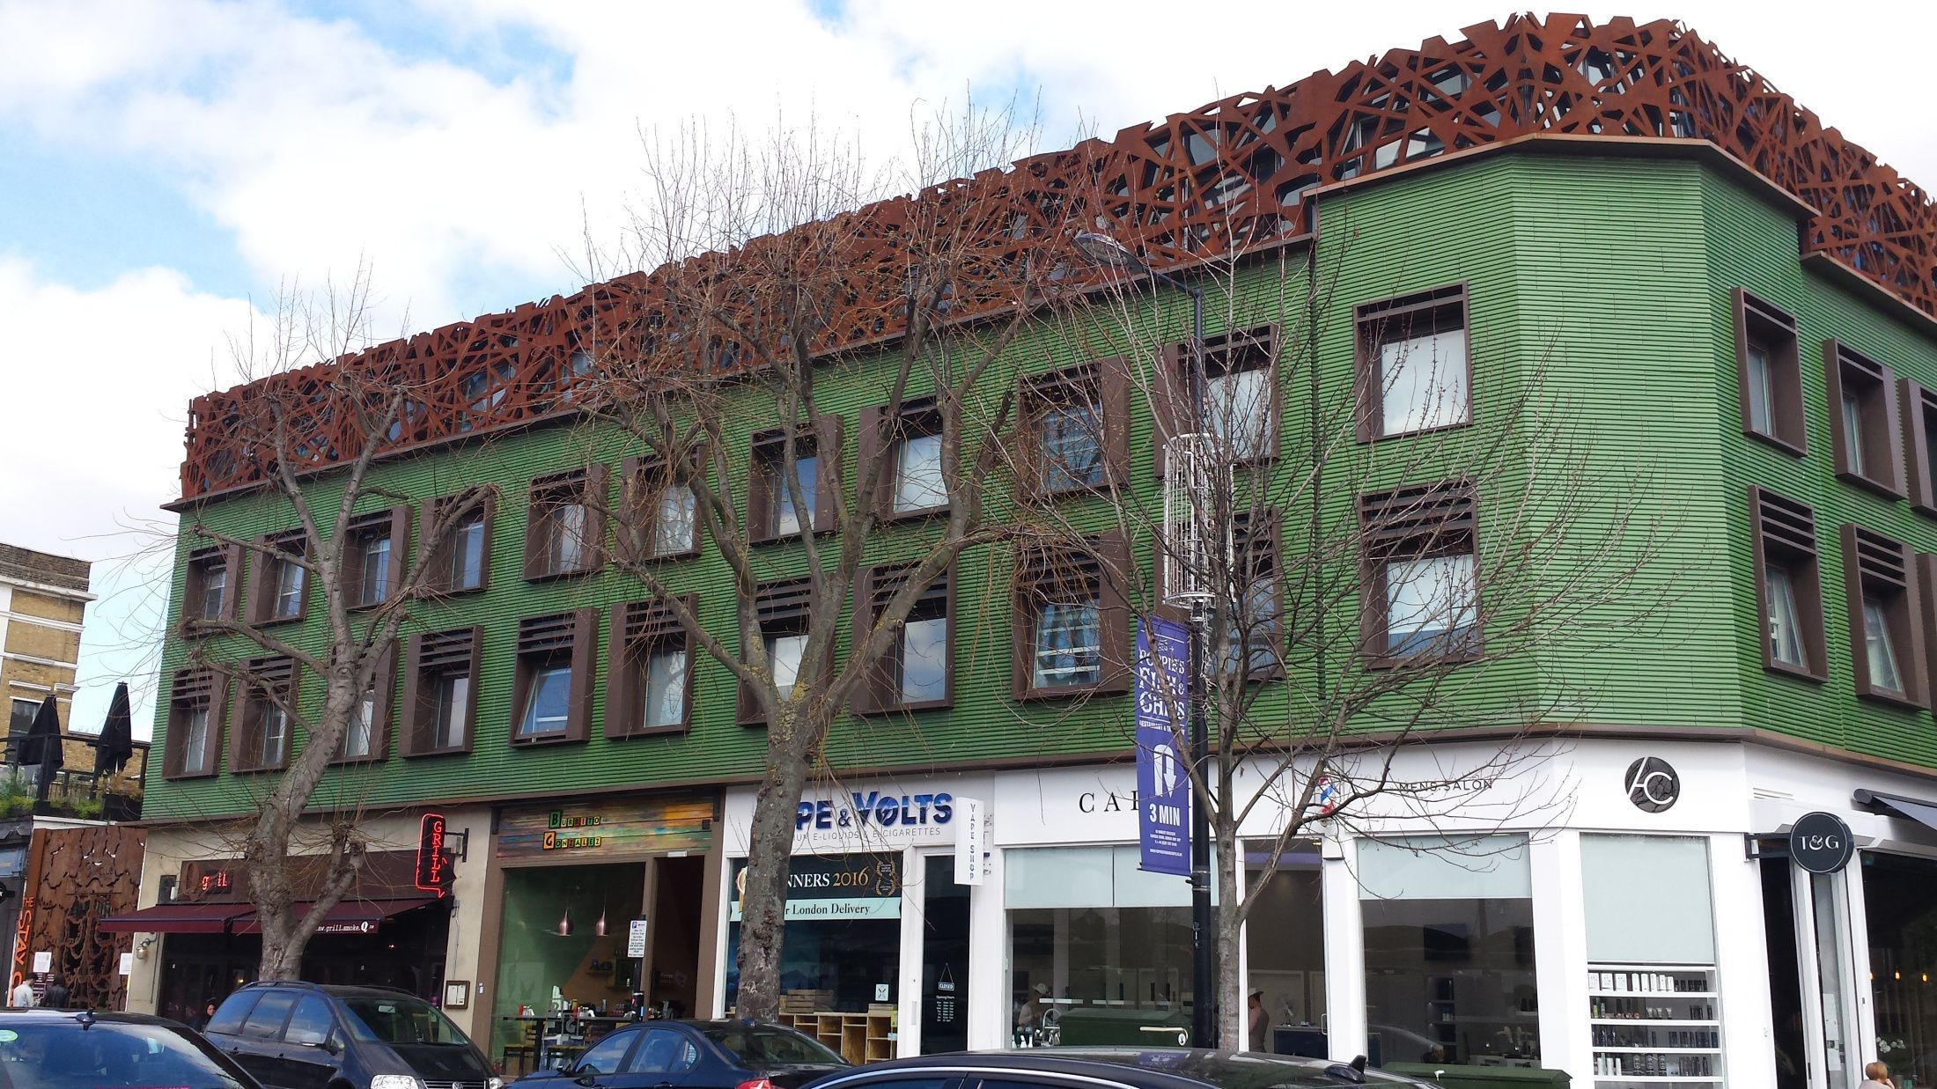
CAMDEM TOWN
OUR HOSTEL IN
CAMDEN TOWN

Slide 4
CAMDEN TOWN

Slide 5
ITALIAN CREATIVE GIRLS WORKING IN CAMDEN TOWN MARKET

Slide 6
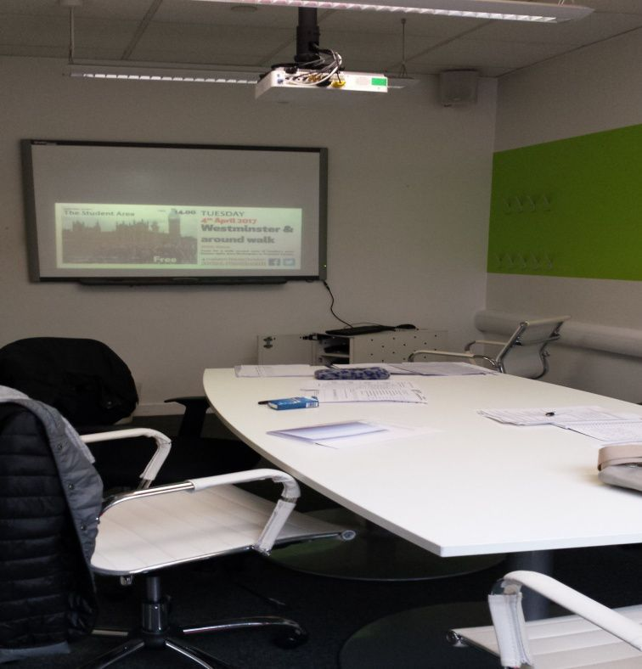
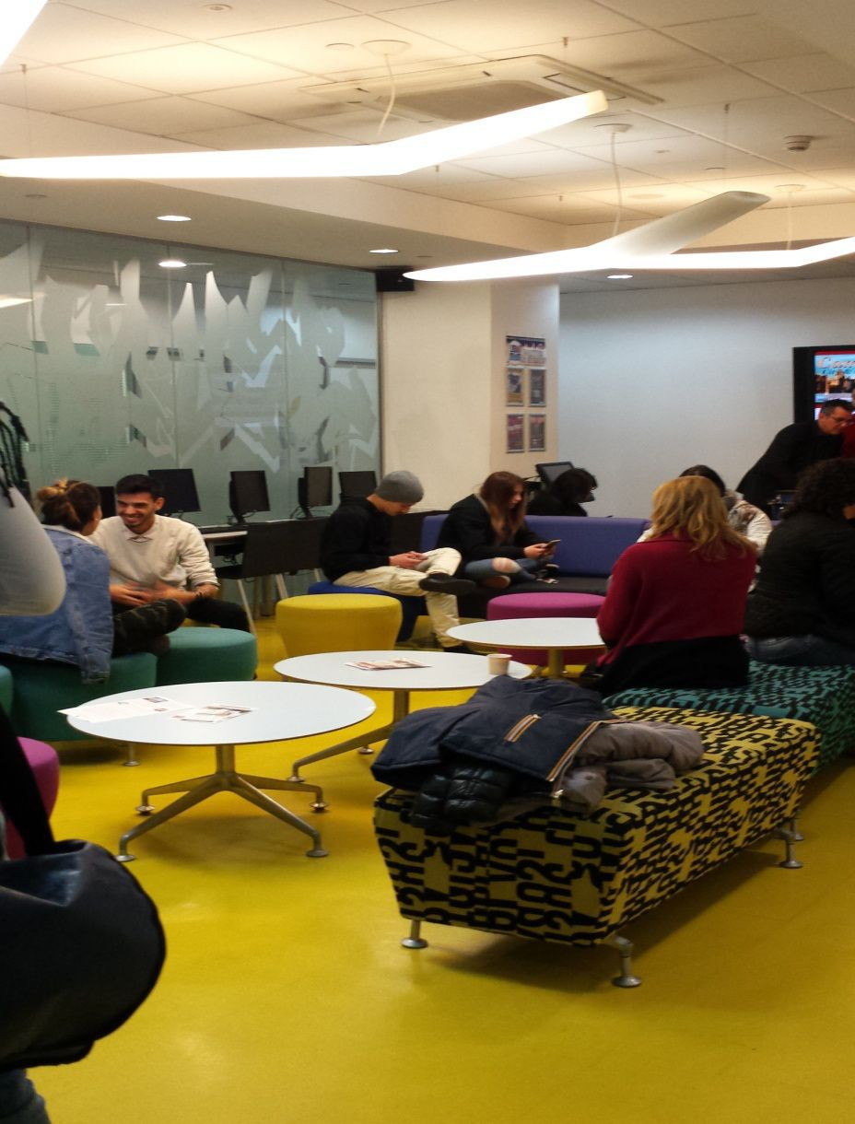
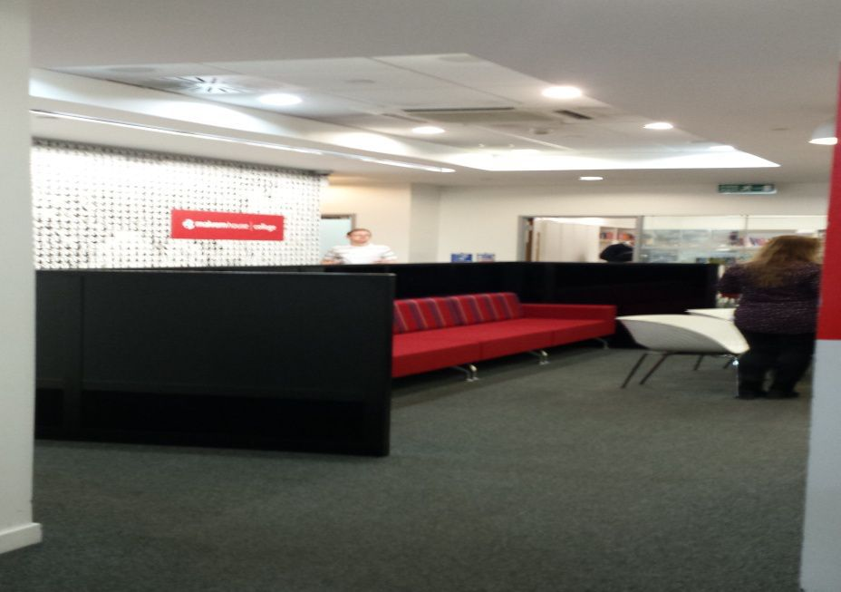
MALVERN HOUSE SCHOOL

Slide 7
OUR DAILY TIMETABLE AT MALVERN HOUSE SCHOOL
As you can see lessons have been divided in two moments
Standard English - Creative Games and Dramatization
English for Literature

Slide 8
Links- Literature Lessons
and other useful resources

Slide 9
Useful Websites
https://learnenglish.britishcouncil.org/en/listen-and-watch
https://www.eslvideo.com/index.php
https://www.engvid.com/

Slide 10
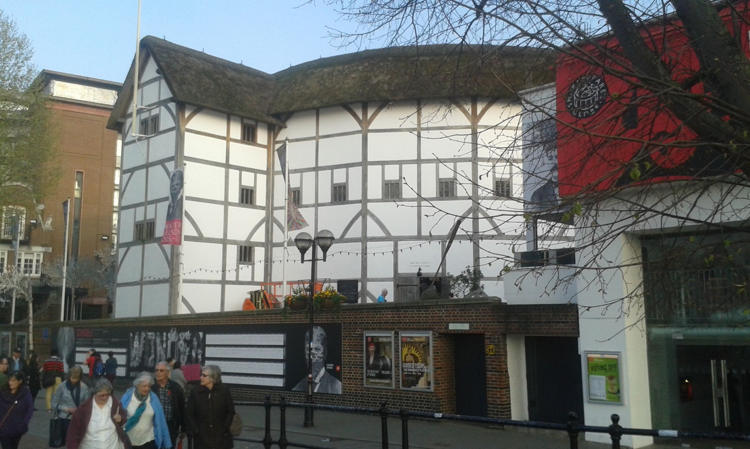
THE WHITE DEVIL
A PLAY AT THE GLOBE

Slide 11
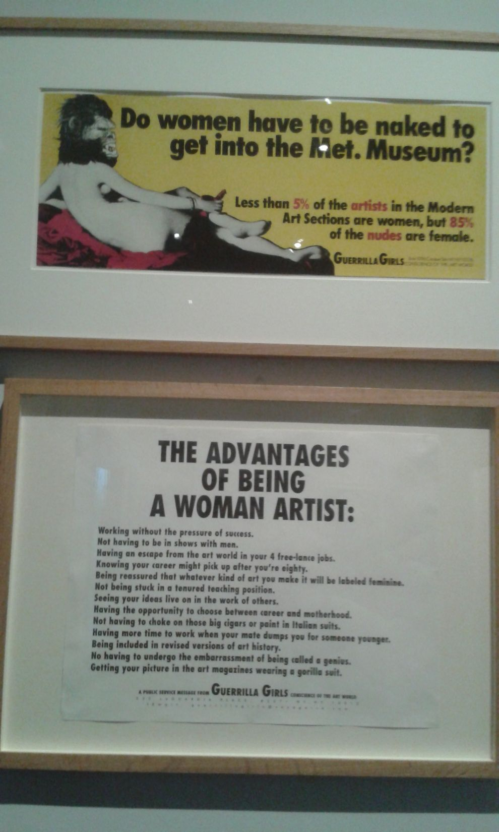
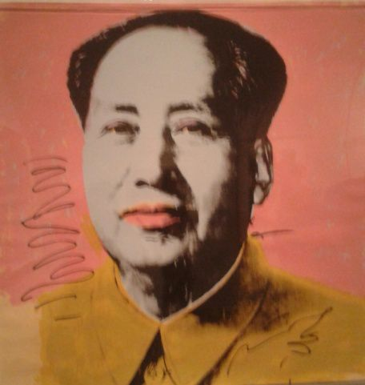
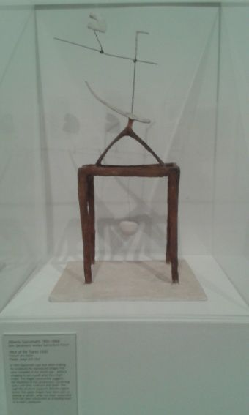
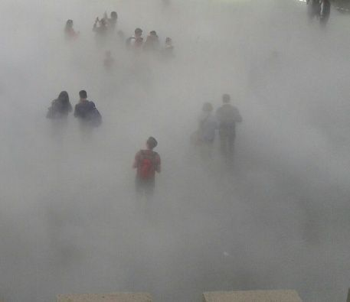
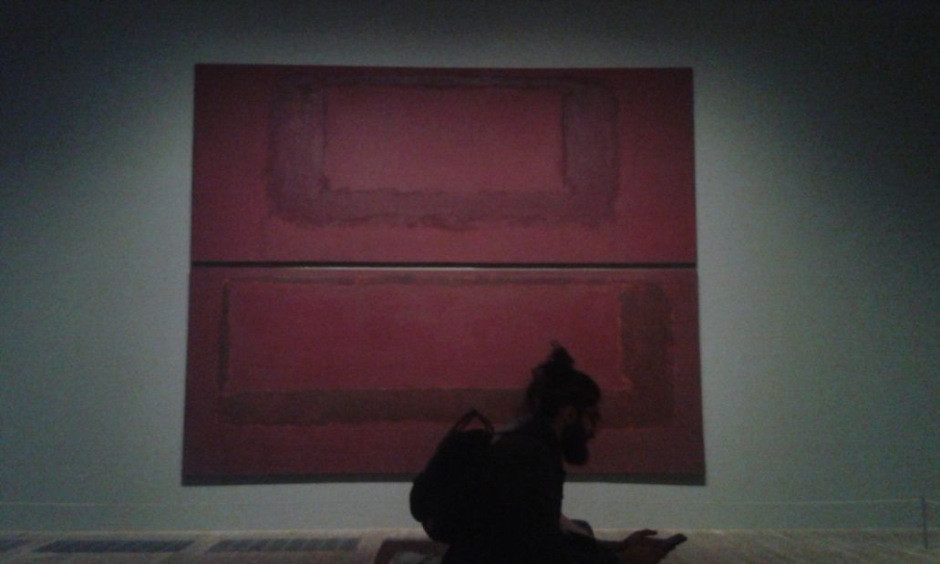
TATE MODERN

Slide 12
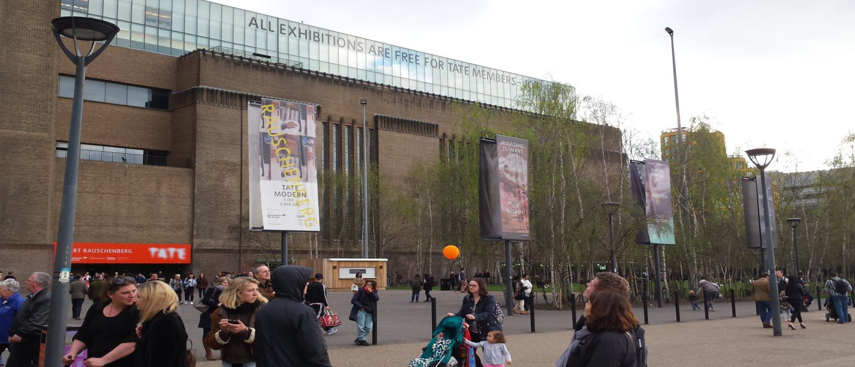
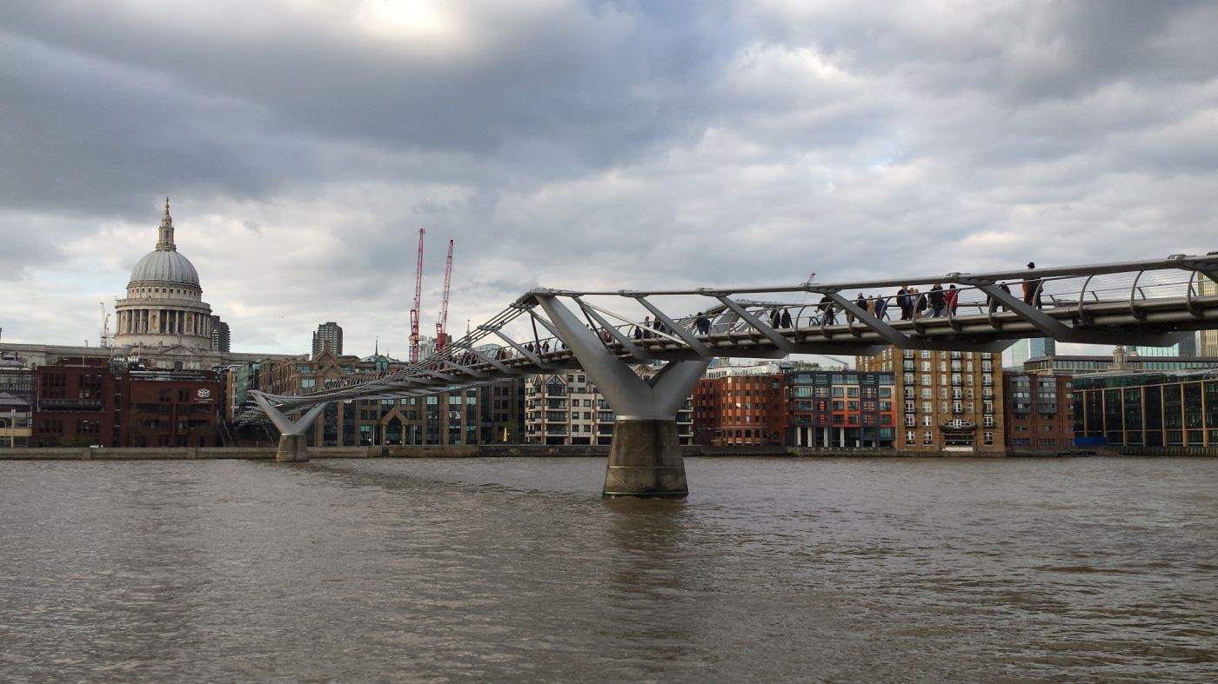
TATE MODERN OUTSIDE

Slide 13
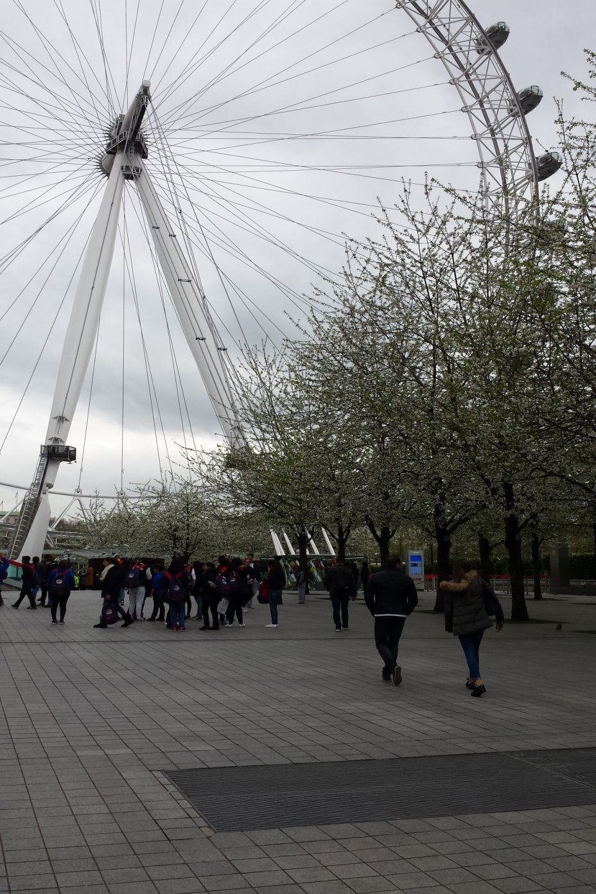
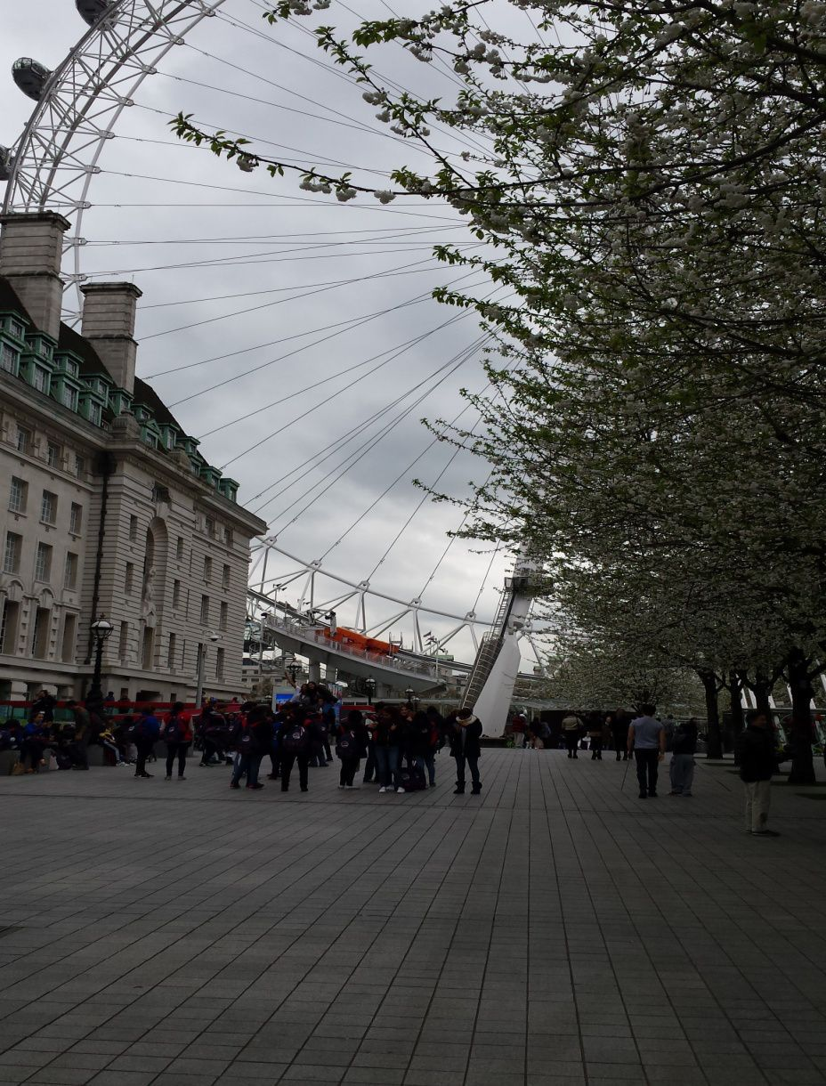
The london eye

Slide 14
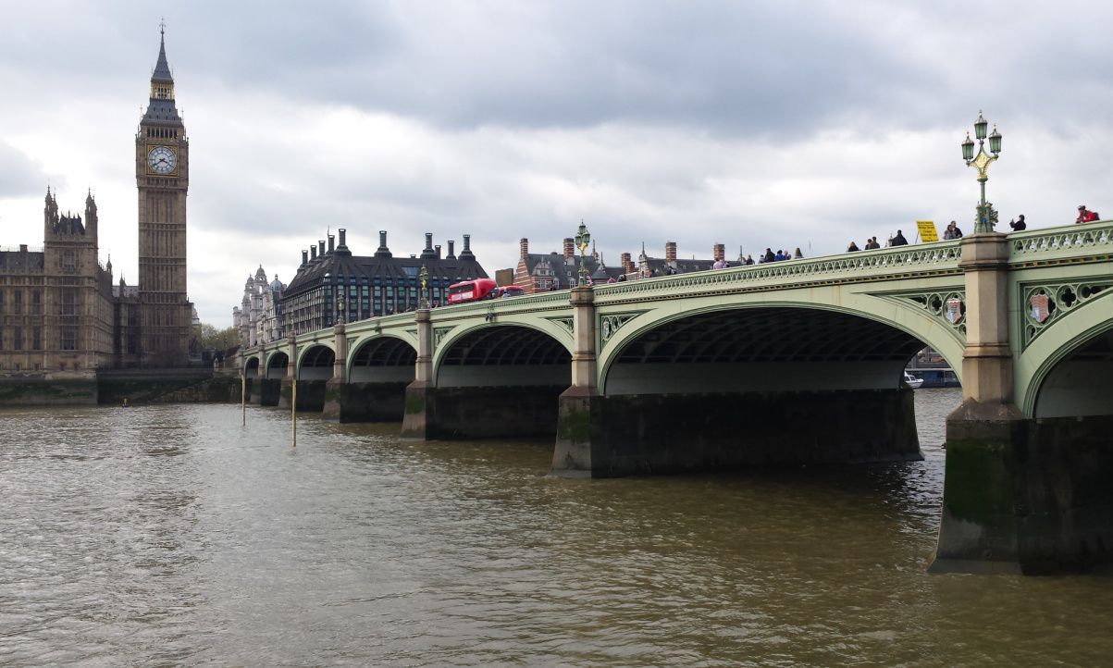
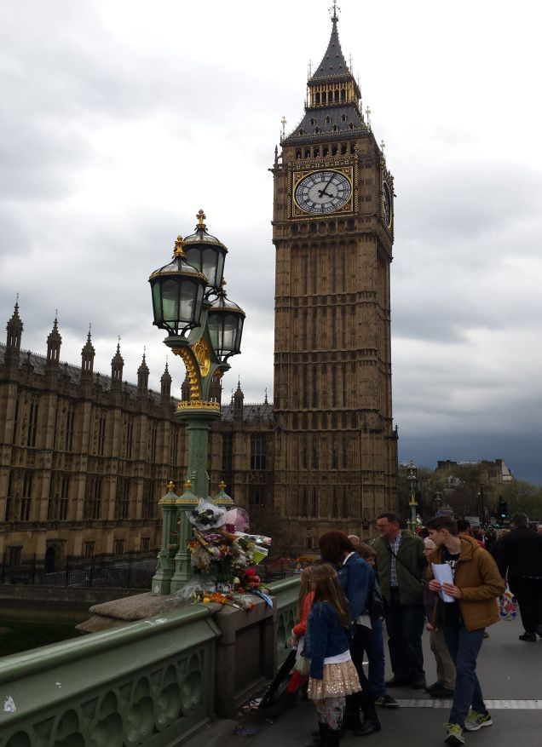
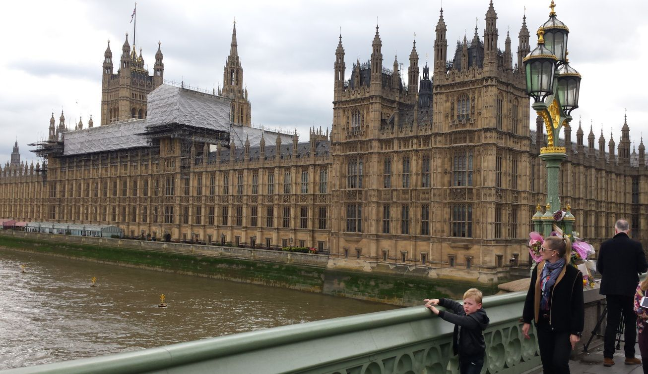
ALWAYS THE SAME STUFF

Slide 15
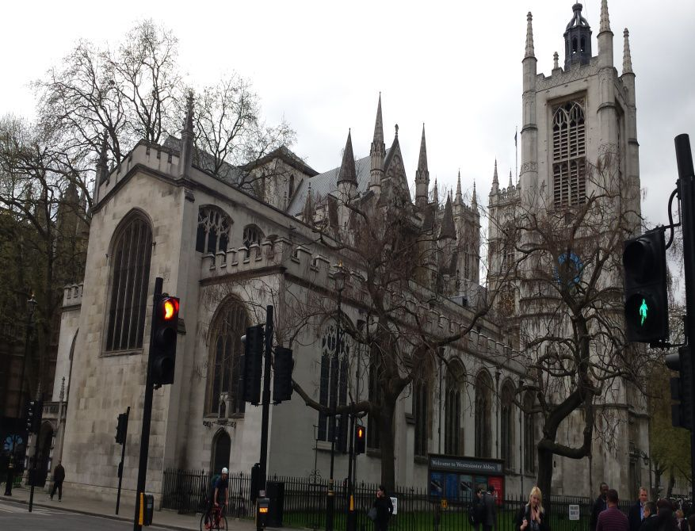
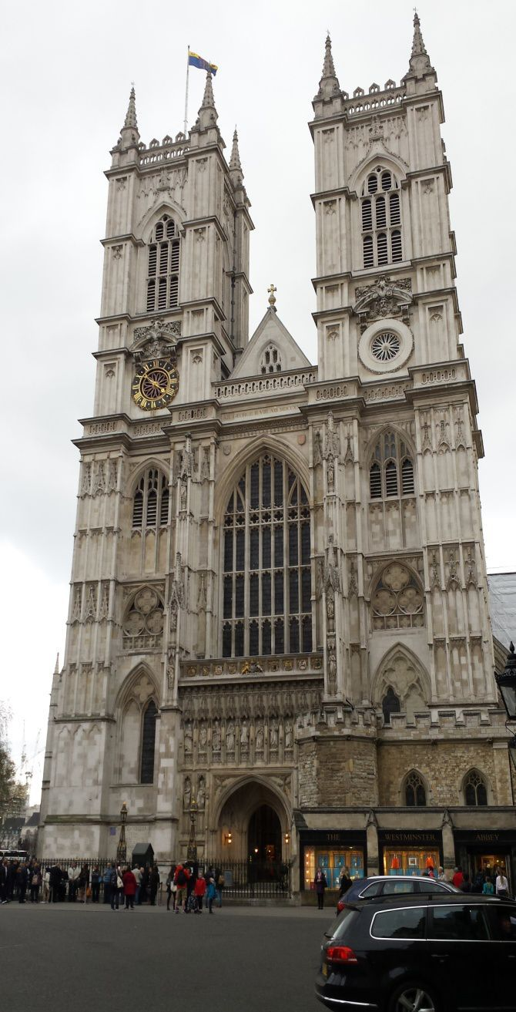
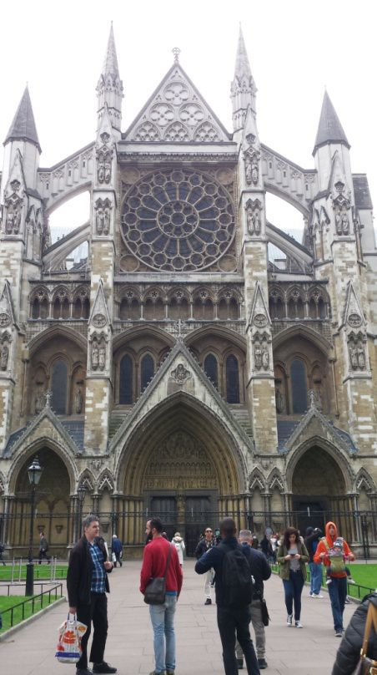
POSTCARDS FROM LONDON

Slide 16
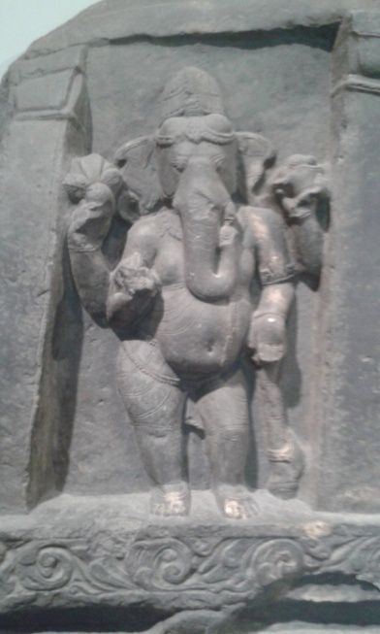
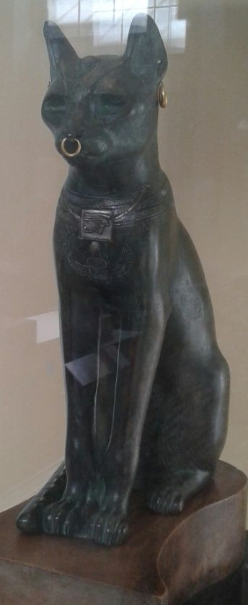
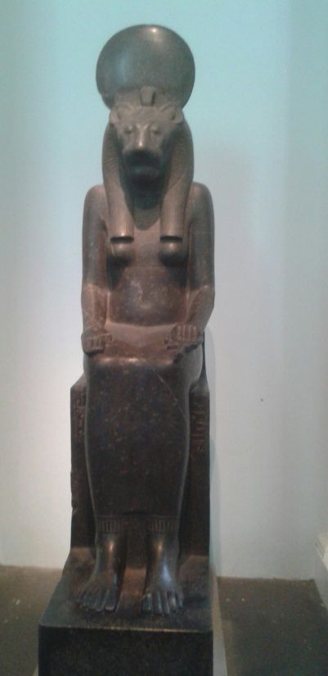
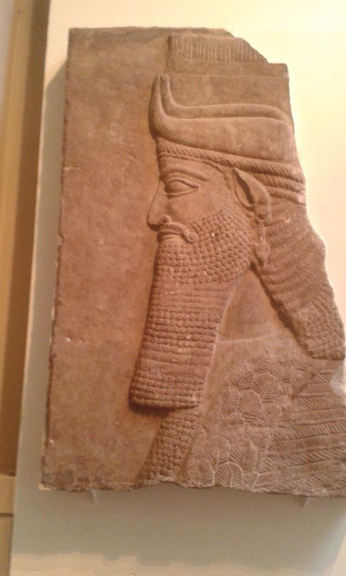
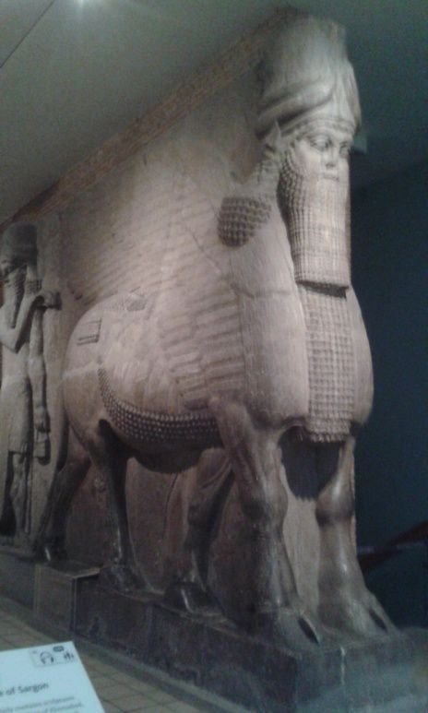
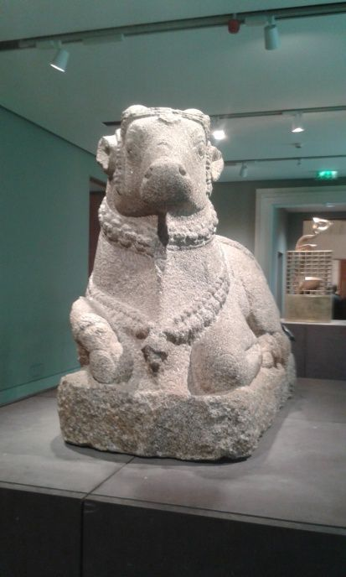
BRITISH MUSEUM

Slide 17
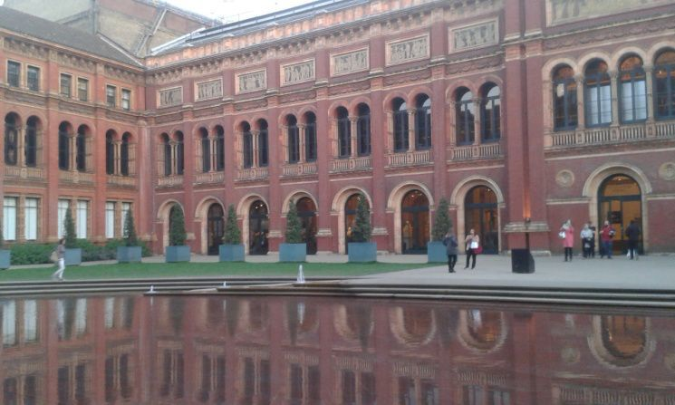
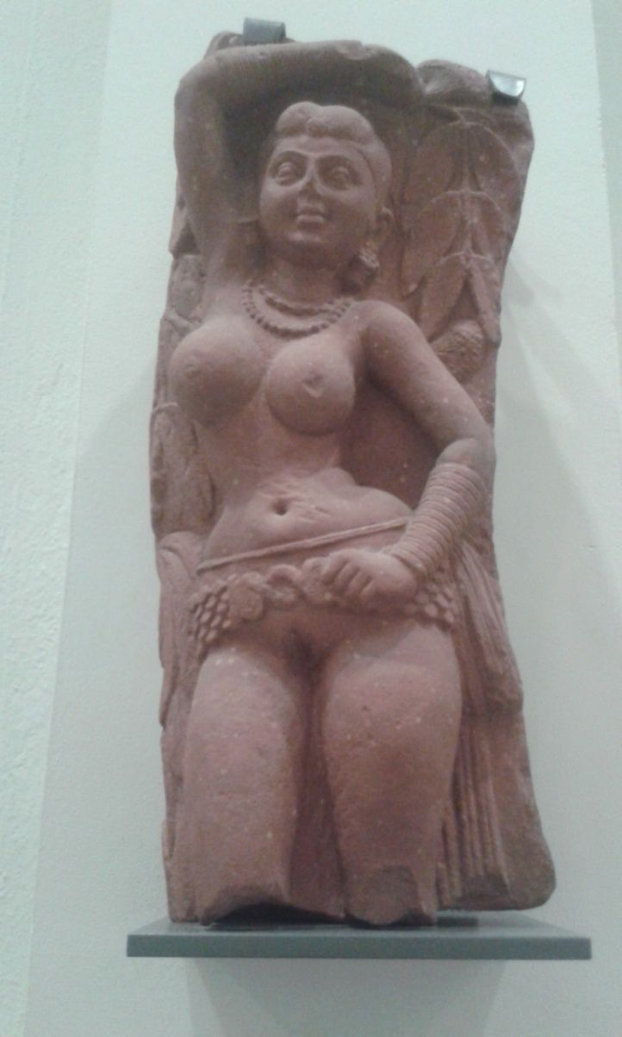
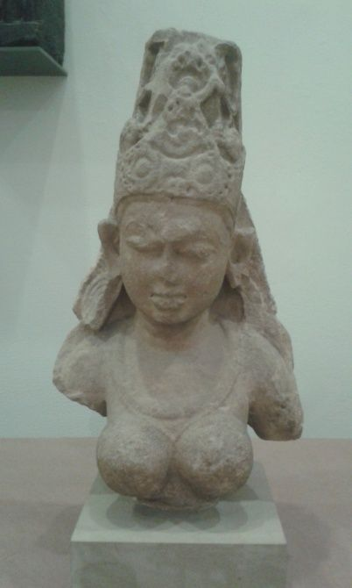
VICTORIA ALBERT MUSEUM

Slide 18
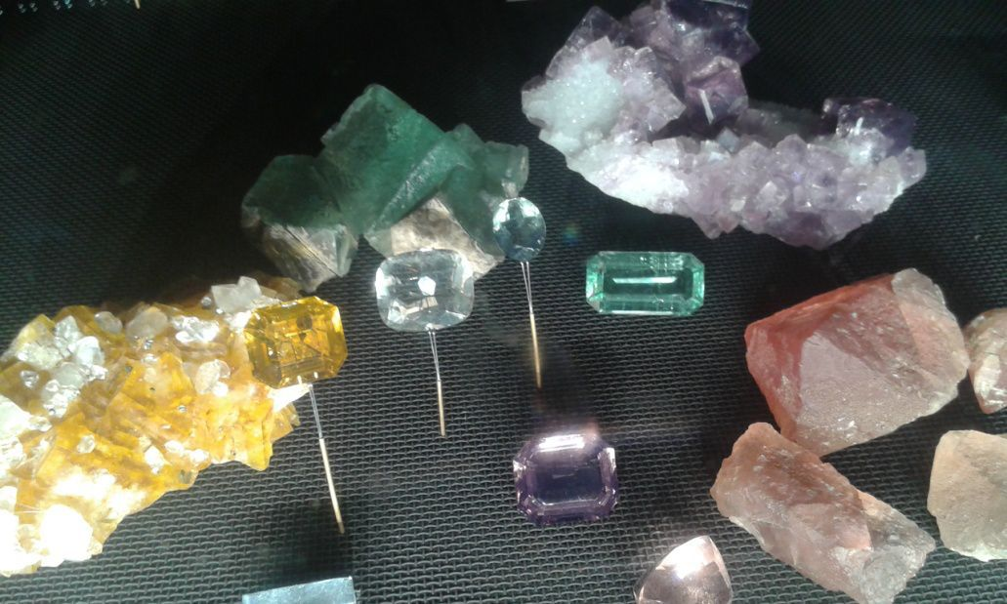
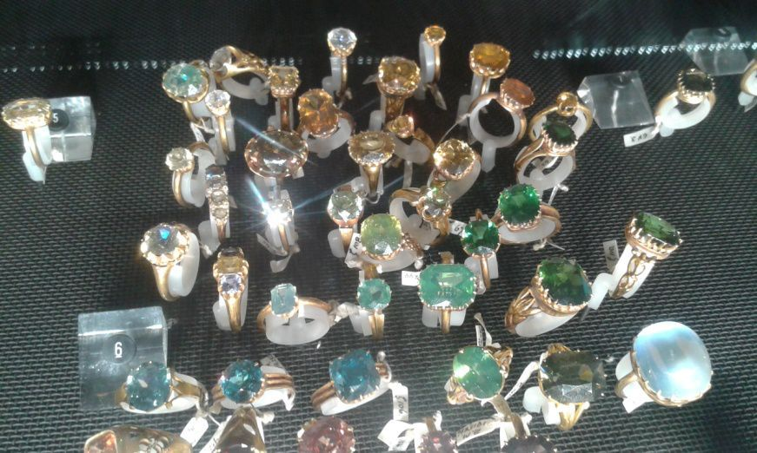
NATURAL HISTORY MUSEUM

Slide 19
CAMDEN TOWN AT NIGHT
CAMDEN TOWN AT NIGHT

